Slide 1
Compression Algorithms

Slide 2
Why do we use compression?
To save space
Hard drives, despite increasing size, always seem to be filled with new programs and data files.
3.5" floppy drives are still used and are still very low capacity.
To save time/bandwidth
Programs and files are now downloaded from the internet rather than provided on a floppy disc.
Compressed files allow for faster transfer times, and allow more people to use a server at the same time.

Slide 3
Types of compression
Lossy - some data is irretrievably lost during the compression process
Ex: MP4, JPEG, Dolby AC-3
Good for audio and video applications, where the perception of the user is required.
Gives extremely large amounts of compression, which is useful for large audio and video files.
If the quality is degraded somewhat, the user may not notice or may not care.
Many sophisticated algorithms are used to determine what data to "lose”
and how it will have the least degradation to the overall quality of the file.

Slide 4
Types of compression
Lossless - original file is exactly reproduced when compressed file is decompressed. That is, D(C(X)) = X where C is the compression and D is the decompression operation.
Necessary for files that must be exactly restored. Ex: .txt, .exe, .doc, .xls, .java, .cpp and others.
Will also work for audio and video, but will not realize the same amount of compression as lossy.
However, since it works for all file types, it can be used effectively for archiving all data in a directory or in multiple directories.

Slide 5
Lossless Algorithms
Most modern lossless compression techniques have roots in these algorithms:
Huffman coding - Variable length, one codeword-per-character!
LZ77 - Uses a "sliding" window to compress groups of characters at a time.
LZ78 / LZW - Uses a dictionary to store previously seen patterns, also compressing groups of characters at a time.
We will discuss Huffman and LZW in more detail.

Slide 6
Popular compression programs
unix compress, gif
LZW
pkzip, zip, gzip
LZ77 + Huffman

Slide 7
Huffman Coding
Huffman works with arbitrary bytes, but the ideas are most easily explained using character data, so we will discuss it in those terms.
Consider extended ASCII character set: 8 bits per character.
This code is a BLOCK code, since all code words are the same length. 8 bits yield 256 distinct characters.

Slide 8
Properties of Block Codes
For k bits, 2^{k} distinct characters are possible.
For N characters, bits are required.
Example: Suppose we have N = 96 characters. Then

Slide 9
Idea of Huffman Coding
What if we could use variable length code words, could we do better than ASCII?
Idea is that different characters would use different numbers of bits.
If all characters have the same frequency of occurrence per character we cannot improve over ASCII.
What if characters had different frequencies of occurrence? Ex: In English text, letters like E, A, I, S appear much more frequently than letters like Q, Z, X.
Can we somehow take advantage of these differences in our encoding?

Slide 10
Is variable-length encoding feasible?
Decoding a block code is easy since we take the next 8 bits.
Decoding a variable length code is not so obvious.
What can go wrong? (see board)
How do we compress?
Let's use fewer bits for our more common characters, and more bits for our less common characters. (Scrabble, Wheel of Fortune)
Notes:
See example on board showing ambiguity if PP is not met.
Suppose
'A' = 11
'B' = 10
'C' = 1110
'D' = 1011
'E' = 1111
'F' = 1010
Decode the message 10111110?
Many interpretations: 1
10 11 1110 / \
B A C 1 0
/ \ / \
1011 1110 1 0 1 0
D C / \ / \ /\
1 0 1 0 1 0
10 1111 10
B E B
10 11 11 10
B A A B
'A' appears as a prefix of 'C' and 'E’
'B' appears as a prefix of 'D' and 'F'

Slide 11
Huffman Algorithm
Assume we have k characters and that each uncompressed character has some weight associated with it (i.e. its frequency of occurrence).
Initialize a forest, F, to have k single node trees in it, one tree per character, and storing the character's weight.
while (|F| > 1){ Find the two trees, T1 and T2, with the smallest weights Create a new tree, T, whose weight is the sum of T1 and T2 Remove T1 and T2 from the F, and add them as left and right children of T Add T to F
}

Slide 12
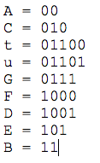
Example
0
1
1
0
1
0
0
1
0
0
1
1
0
1
0
1
A 20
C
10
t
2
u
3
G
5
F
6
D
9
E
15
B
30

Slide 13
How do we decode?
start at root of tree and first bit of file
while not at end of file{
if current bit is a 0, go left in tree else go right
if we are at a leaf output character go to root
read next bit of file
}
Notes:
Decode the message: 10110001111011100101
101 1000 11 11 0111 00 101
E F B B G A E

Slide 14
How to Encode?
let's process the tree once (preorder traversal) to build Huffman tree.
**A*C**tuG***FDEB

Slide 15
How do we measure the compression?
Block Code: 9 different characters => = 4 bits, so 100 characters * 4 bits = 400 bits
Huffman: 'A' 'B' 'C' 'D' 'E' 'F' 'G' 't' 'u’
20 * (2) + 30 * (2) + 10 * (3) + 9 * (4) + 15 * (3) + 6 * (4) + 5 * (4) + 2 * (5) + 3 * (5) = 280 bits

Slide 16
How do we measure compression?
Compression ratio = uncompressed / compressed Example: Compression ratio = 400 / 280 ~ 1 / .7
Space savings = 1 – compressed / uncompressed Example: Space savings = 1 – 280 / 400 = 3 / 10 = 30%

Slide 17
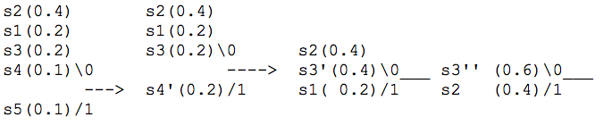
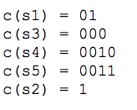
Dealing with equal frequencies
Build Huffman Tree on the board
.2 * 2 + .2 * 3 + .1 * 4 + .1 * 4 + .4 * 1 = 2.2 bits / character

Slide 18
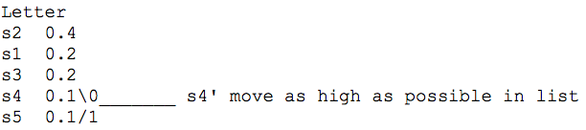


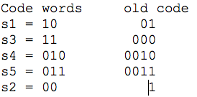

Dealing with equal frequencies
What if we move the combinations as high as possible during the construction.
Is there a difference?
Notes:
L = 2*0.2 + 2*0.4 + 2*0.2 + 3*0.1 + 3*0.1 = .4 + .8 + .4 + .3 + .3 = 2.2 bits/symbol
Yes the variance of this code is a minimum! Why is this important?
Assume that 10,000 symbols per second are transmitted with 2.2 bits per symbol.
So transmission capacity expects 22000 bits per second. Generally the bits are placed
in a buffer to smooth out the variation during transmission where the buffer is of fixed size.
The greater the variance the more difficult to manage the buffer!
This code is called a minimal variance Huffman code.
Suppose s4 = 0010 and s5 =0011 are generated for a few seconds.
old code - code generates 40000 bits per second => exceeds capacity: 18000 bits per second
new code - code generates 30000 bits/second => exceeds capacity: 8000 bits per second
Suppose a string of s2 = 1
old code - code generates 10000 bits per second implying a deficit of 12000 bits/second
new code - code generates 20000 bits/second implying deficit of 2000 bits/second

Slide 19
Non-Binary Huffman Code
number of symbols = r + a(r-1) where r = size of alphabet and ‘a’ an integer. If ‘a’ is not an integer increase the number of symbols so ‘a’ is an integer. These symbols are called dummies and have probability 0.0.
Combine r symbols at a time!

Slide 20
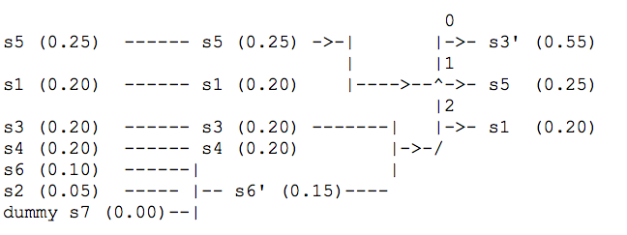
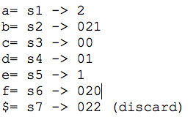
Example
Notes:
Example:
Suppose S (symbols) = {s1, s2, …, s6} and probabilities
p1 = 0.20, p2 = 0.05, p3 = 0.20, p4 = 0.20, p5 = 0.25, p6 = 0.10.
X = {0,1,2} our code alphabet this implies r = 3. So, number of symbols is 6.
Number of symbols is 6 = r + a(r-1) = 3 + 2*a but a is not an integer.
So increase the number of symbols to 7 = 3 + 2*2. Let s7 is a dummy with probability 0.00.
Now the probabilities become p1 = 0.20, p2 = 0.05, p3 = 0.20, p4 = 0.20, p5 = 0.25, p6 = 0.10, p7 = 0.0.

